Slide 1
Cell Phone Design Challenge

Slide 2
Materials Science
Physics
Why are materials different colors?
Why do some materials conduct electricity?
How do magnets work?
Chemistry
Which materials can capture CO₂?
How can we make batteries last longer?
How do we make new materials?
Engineering
Which materials can withstand earthquakes?
How can we balance money and environmental costs?

Slide 3
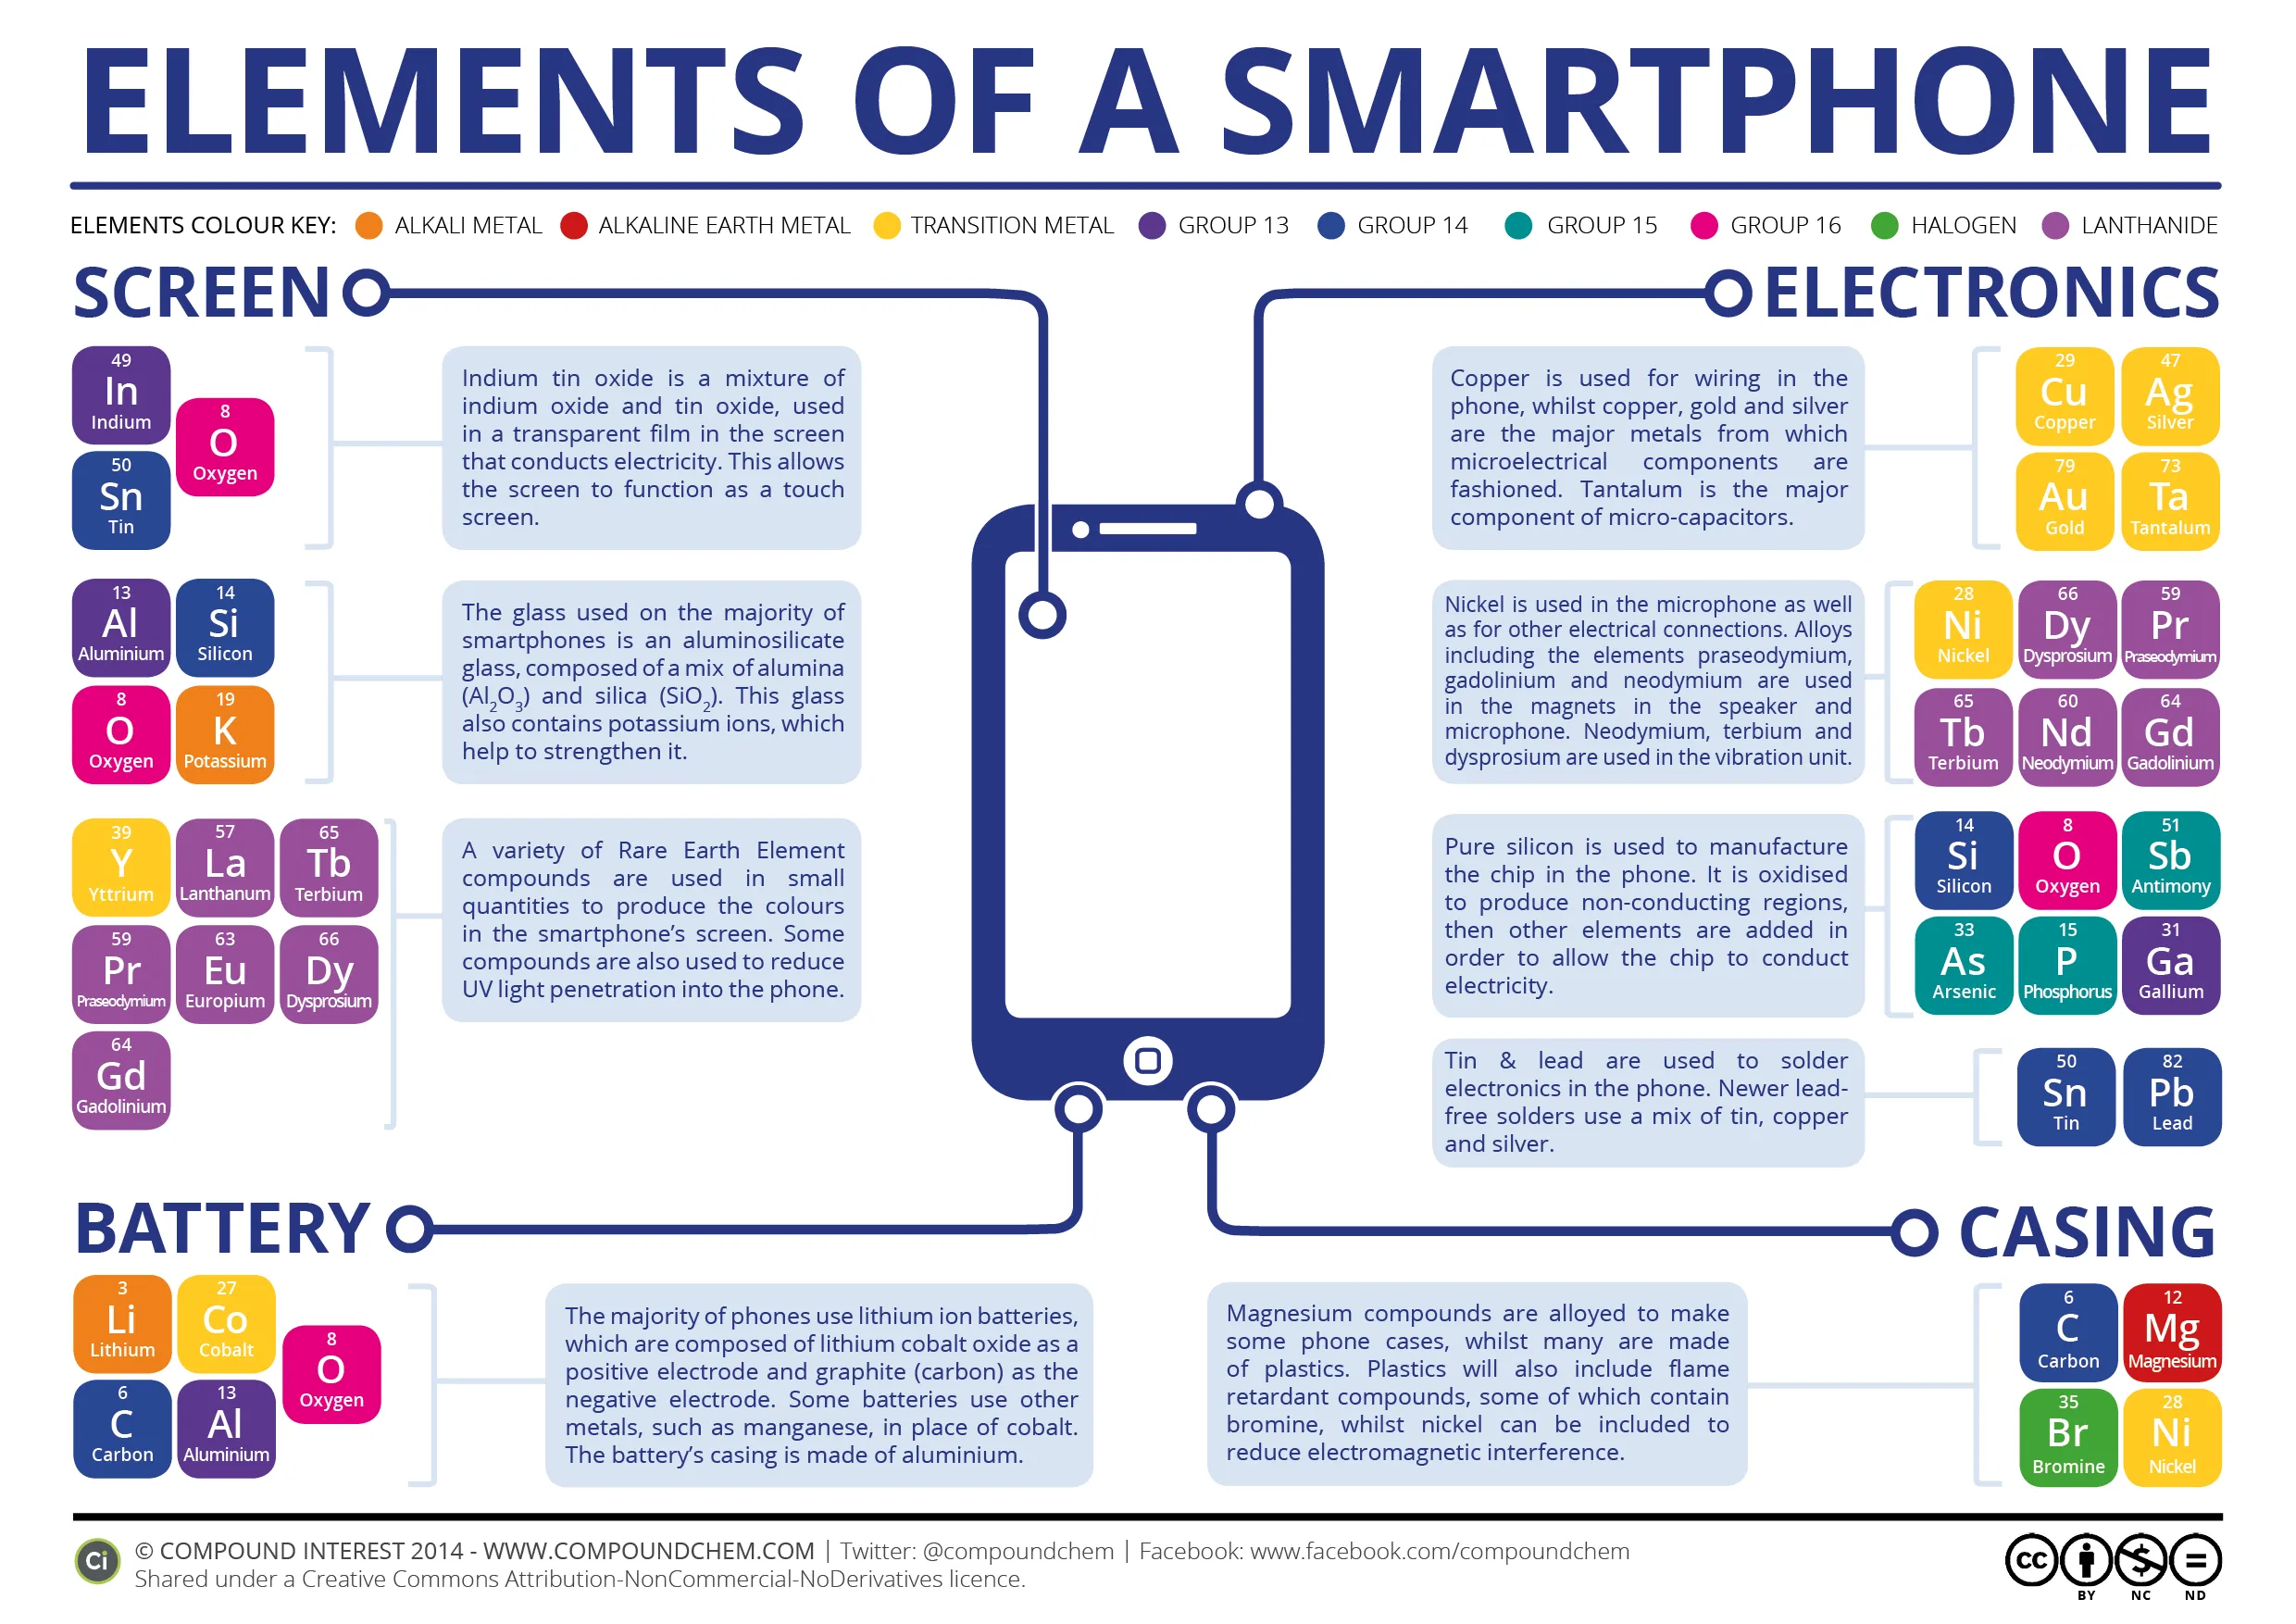
Materials are everywhere!
https://www.acs.org/education/resources/undergraduate/chemistryincontext/interactives/portable-electronics/creation-gorilla-glass.html

Slide 4

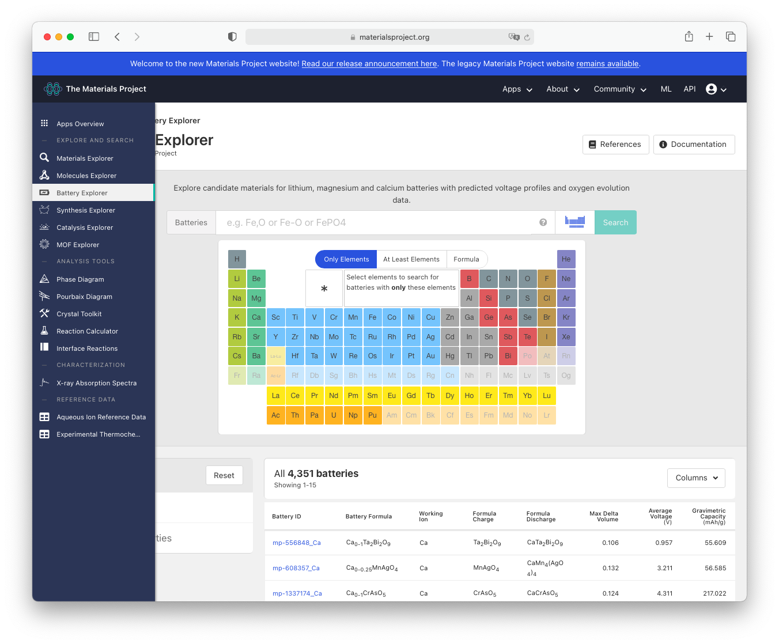
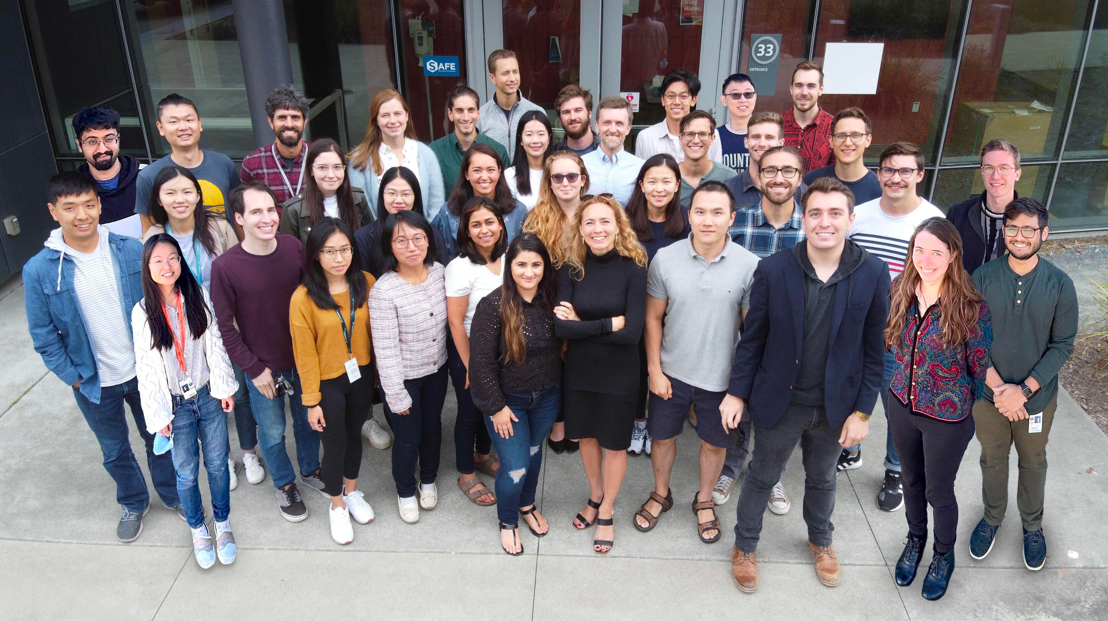
The Materials Project: Using Data Science to Discover New Materials
materialsproject.org
A free online database of computed properties for over 150,000 inorganic compounds
Powered by more than 40 researchers at Berkeley Lab and several universities (in the photo: the Persson group at Berkeley Lab)

Slide 5

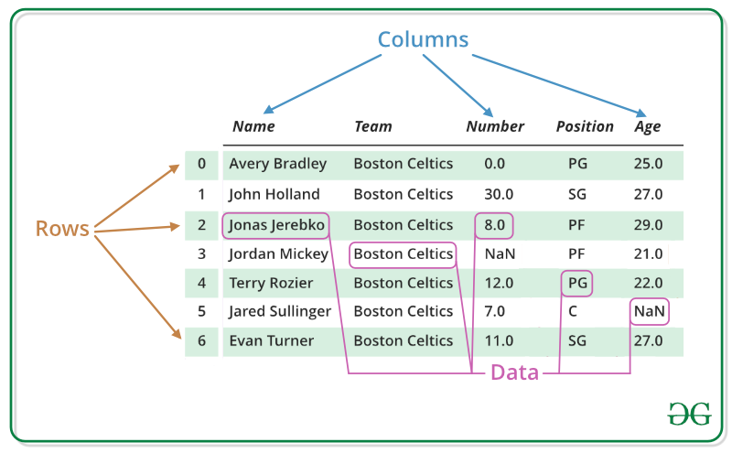
pandas
Library that allows us to work with data sets.
It has functions for analyzing, cleaning, exploring, and manipulating data.
Data is often read into dataframes (tables with rows and columns)
Notes:
First notebook uses pandas
import ____ as __
import pandas as pd

Slide 6
Notebook: CellPhoneDesignChallenge_1
Will your phone make it to the market?!

Slide 7
Stretch Break!

Slide 8
Cell Phone Design Challenge - Machine Learning

Slide 9

Definitions
Artificial Intelligence (AI): The effort to automate intellectual tasks normally performed by humans
Machine Learning (ML): AI technique that teaches computers to learn from data
Set of tools and techniques to find patterns in data
Machine learning is a subset of Artificial Intelligence
Chollet (2018) Deep Learning with Python

Slide 10
Training Data
Many (but not all) machine learning systems “learn” by taking a series of input data and output data and using it to train a model.
What might be some potential issues with training data that you should keep in mind?
Notes:
Lack of data, biases, feeding in unrelated data (garbage in = garbage out)

Slide 11

Training Data - Biases

Slide 12
Types of Machine Learning
Supervised ML A human trains the ML model by using labeled training data (dataset with expected outcomes). |  | Unsupervised ML The ML model is given unlabeled data and finds similarities, differences, and patterns of the data without prior training.
Regression | Classification | Clustering
Understand relationships between dependent and independent variables in order to predict data | Assign data into specific categories | Group unlabeled data based on their similarities and differences
Examples: Predicting house prices based on certain features, predicting commute times based on traffic conditions | Examples: Detecting spam emails, image classification | Examples: Categorizing news videos from different media outlets, identifying streaming services viewers with similar behavior
Notes:
Regression - continuous variables; classification - discrete variables

Slide 13
We can use machine learning to help us predict or classify data.
Types of ML algorithms
Regression | Classification
Predict a value (or set of values) given a set of inputs. | Classify data into specific categories.
Examples: Predicting house prices based on certain features, predicting commute times based on traffic conditions | Examples: Detecting spam emails, image classification
Notes:
Review from Cell Phone Design Challenge

Slide 14
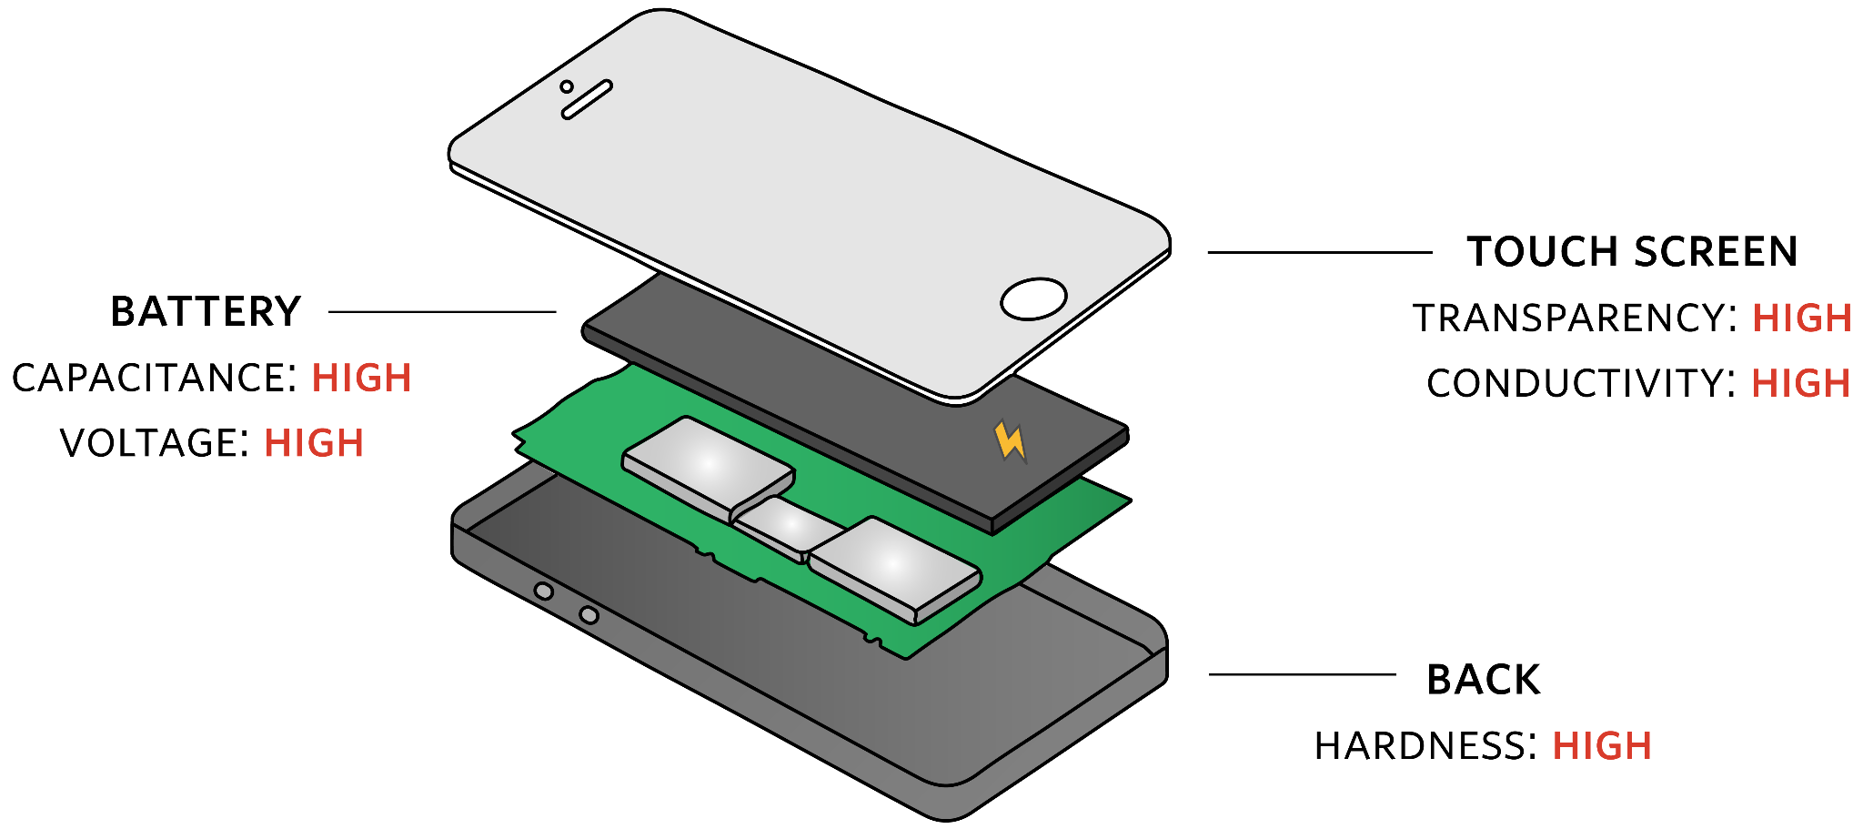
Back to the Cell Phone Design Challenge!
Task: Train a machine learning model to predict the hardness of a material based only on its density
What type of machine learning is this? (Regression vs. classification)
Notes:
Regression (predicting data, finding relationship between two variables - density/hardness)

Slide 15
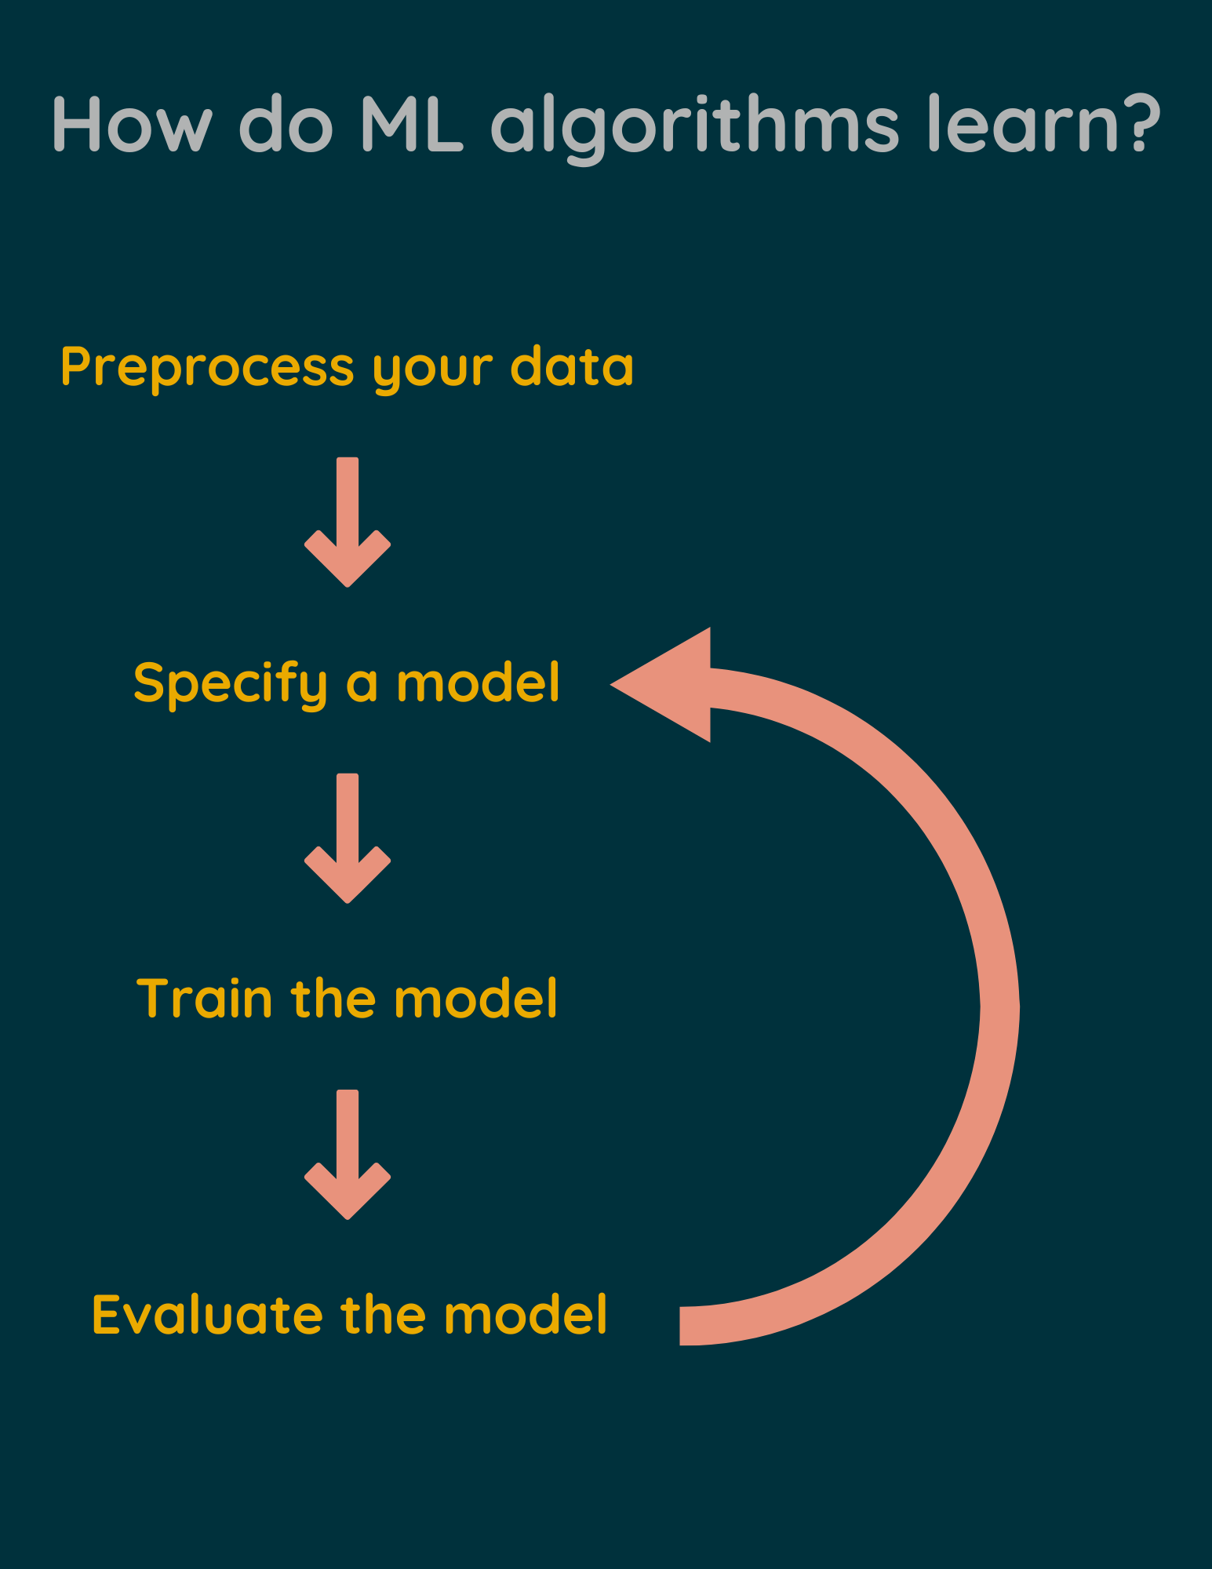
dlab.berkeley.edu

Slide 16
Cell Phone Design Challenge ML Task - Implementation
1) Preprocess your data
Understanding and cleaning the data (done in previous notebook)
Create a training data set:
This will be used to train the ML model to predict hardness based on density
Data where hardness is already calculated (i.e. NOT NaN)

Slide 17
Cell Phone Design Challenge ML Task - Implementation
In the end you should have the following sets of data
X (training data): Density for each material.
y (target variable): Hardness for each material.
Remember our goal: train a machine learning model to predict the hardness of a material based only on its density.
In order to train the model, we need to first give it data of materials that have density and hardness values.
Once the model is trained, we can use it for predictions.

Slide 18
Cell Phone Design Challenge ML Task - Implementation
2) Specify a model
Python machine learning library scikit-learn implements various machine learning models
We will be using the Random Forest Regressor model
Notes:
Guide on RandomForestRegressor(): https://scikit-learn.org/stable/modules/generated/sklearn.ensemble.RandomForestRegressor.html#sklearn.ensemble.RandomForestRegressor
An explanation of this model: https://towardsdatascience.com/random-forest-regression-5f605132d19d

Slide 19
Cell Phone Design Challenge ML Task - Implementation
3) Train the model
Provide the model with the training data: density of materials which already has the hardness calculated
Provide the model with the target property: hardness of materials

Slide 20
Cell Phone Design Challenge ML Task - Implementation
4) Evaluate the model
Compare the predicted hardness from the ML model to the actual hardness of materials
How can we quantify this comparison?

Slide 21
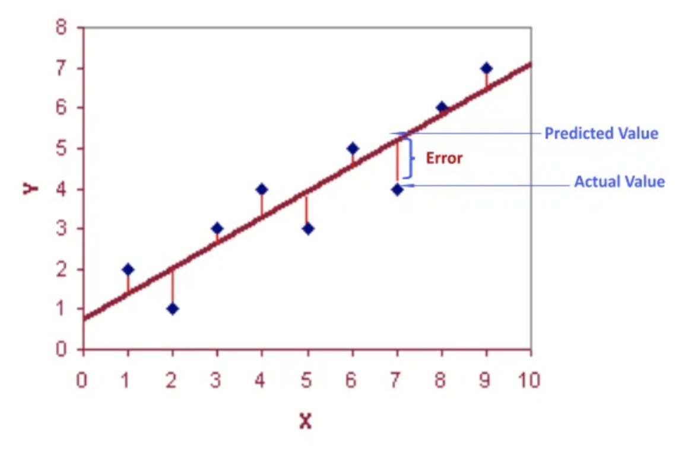
Evaluating a Machine Learning Model
Root Mean Squared Error (RMSE)
Shows how close the actual values are to the model’s predicted values
The smaller the RMSE, the better the fit
Notes:
Mean Squared Error = average of summation of squared difference between the actual output value and the predicted output value
Root Mean Squared Error = take the square root of the MSE

Slide 22
Evaluating a Machine Learning Model
Plot data
Plot actual hardness values against predicted hardness values

Slide 23
Let’s try! Complete:
Section 1 - Read in the Data Set
Section 2 - Training Our Machine Learning Model
Section 3 - Predicting the Hardness of Novel Materials

Slide 24
Evaluating a Machine Learning Model:
Comparing Results - RMSE
What values did we get for RMSE?
What is the average hardness value of the data set? (Can find it with code)

Slide 25
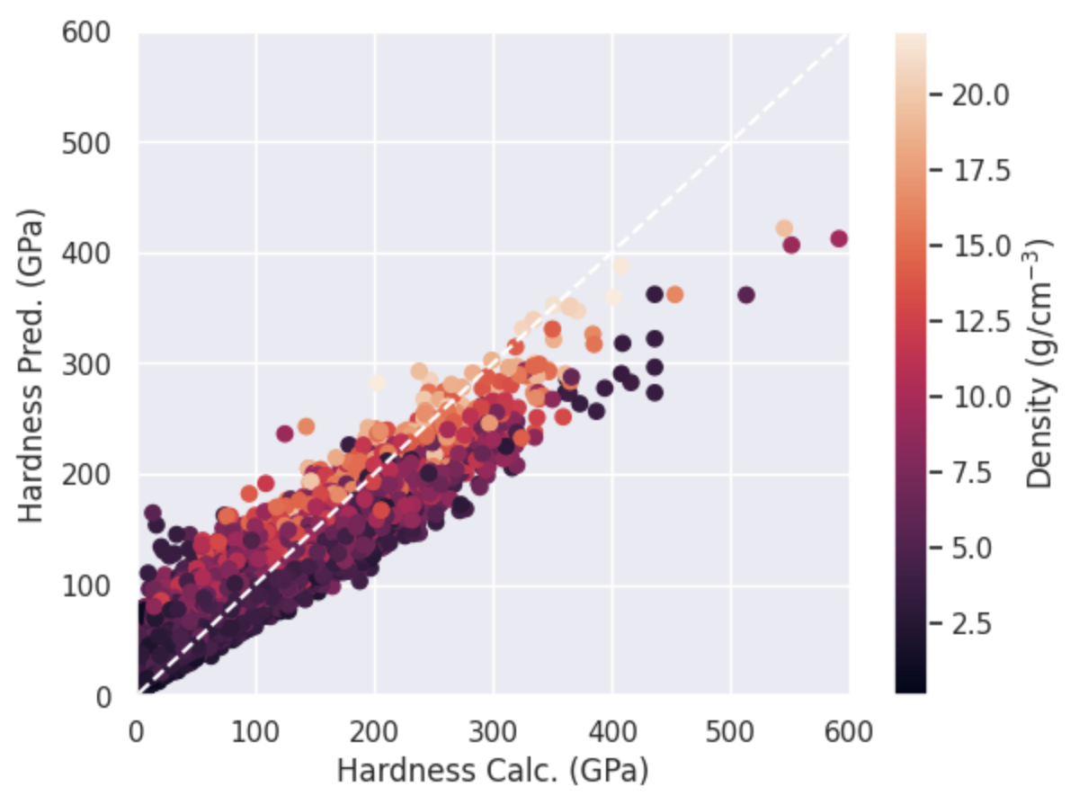
Evaluating a Machine Learning Model: Plot
Notes:
Students should get similar looking graphs

Slide 26
Evaluating a Machine Learning Model
Generally, we want models that perform well on both the training and the test data.
A model that performs poorly on the training data is called underfit.
A model that performs well on the training data and poorly on the testing data set is called overfit.

Slide 27
Cell Phone Design Challenge ML Task - Implementation
Repeat!
Try out different models and see which performs best for your task.
Once you are satisfied with a model, go back to the original dataset and use the trained model to predict the hardness of materials that have missing hardness data.
Notes:
Trying different models is a bonus task in the notebook

Slide 28
Complete Section 3 - Predicting the Hardness of Novel Materials
If you are done early, try Section 4 - Bonus: Testing Different Models
(There’s a lot of different models out there - we recommend starting with Ordinary Least Squares, but feel free to explore using the link in the notebook!)

Slide 29
Resources to learn more on machine learning
Introduction to Machine Learning with Scikit Learn
Google Cloud Topics on AI/ML
Scikit-learn user guide

